Slide 1
Microservices Data Consistency Approaches: A tailored approach towards current limitations
PhD 2nd Progress
Asim Riaz
1732102
Supervisor:
Dr. Husnain Mansoor Ali

Slide 2
Contents
Problem Statement
Research Objectives
Research Roadmap
Research Parameters
Related Work
Adaptation Model
References
Q&A

Slide 3
Problem Statement
Software industry heavily relies on custom data consistency implementations while using microservice architecture
Industry have multiple microservices data consistency approaches available at their disposal, however, their adaption is limited
This research will:
Pursue to identify the limitation of existing microservices data consistency approaches
Segregate the limitations that hinder the adaptation of microservices data consistency approaches by industry
Propose potential solutions to overcome selected limitations to increase industry adaptation of microservices data consistency approaches

Slide 4
Research Objectives
Evaluate limitations of microservices data consistency approaches for industry adaptation
Design and proposed adaptation model.
Testing and evaluation of proposed adaptation model.

Slide 5
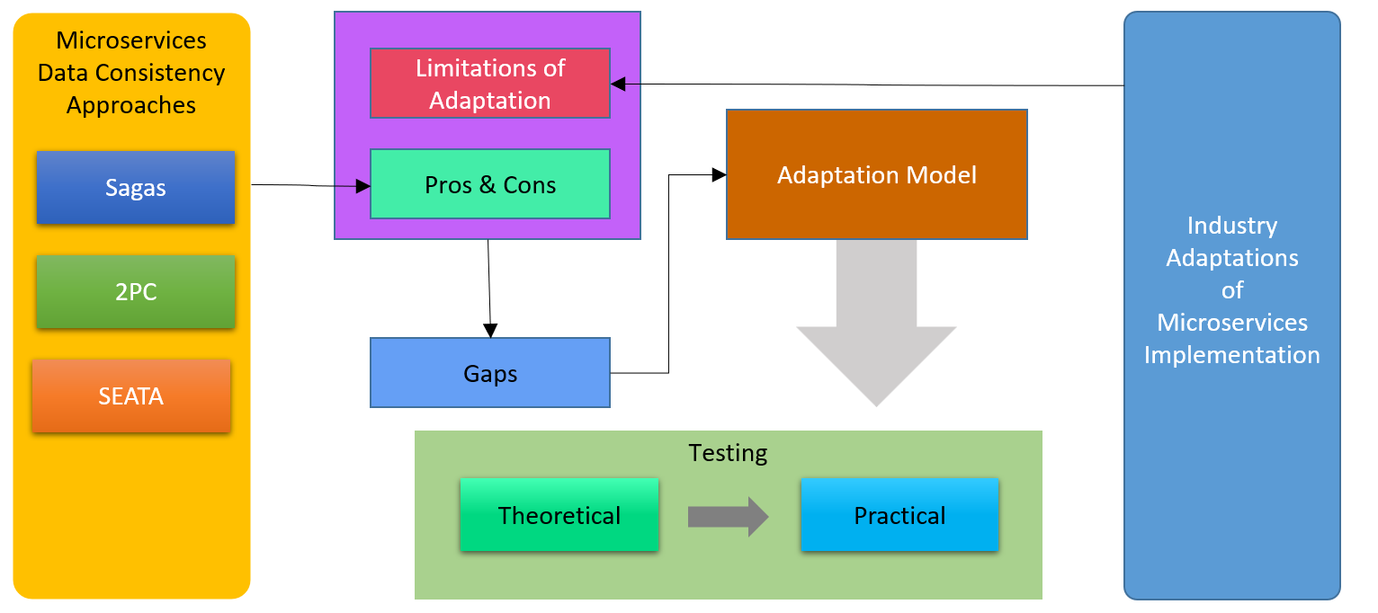
Research Roadmap

Slide 6
Research Work

Slide 7
Parameters for Evaluating Data Consistency in Microservices Architecture
Dirty Reads
A transaction read data from a row that is currently modified by another running transaction [8, 9]
Lost Updates
Two different transactions trying to update the same “data”. One of them doesn’t see the new value when trying to update [8, 27]
Non-repeatable Reads
Re-reads of the same record (during an inflight transaction) don’t produce the same results [7]

Slide 8
Research Work Related Work

Slide 9
Microservice - Data Consistency Approaches
Data management in microservices: state of the practice, challenges, and research directions.[19]
Enhancing Saga Pattern for Distributed Transactions within a Microservices Architecture[10]
Event-Based Data-Centric Semantics for Consistent Data Management in Microservices[31]

Slide 10
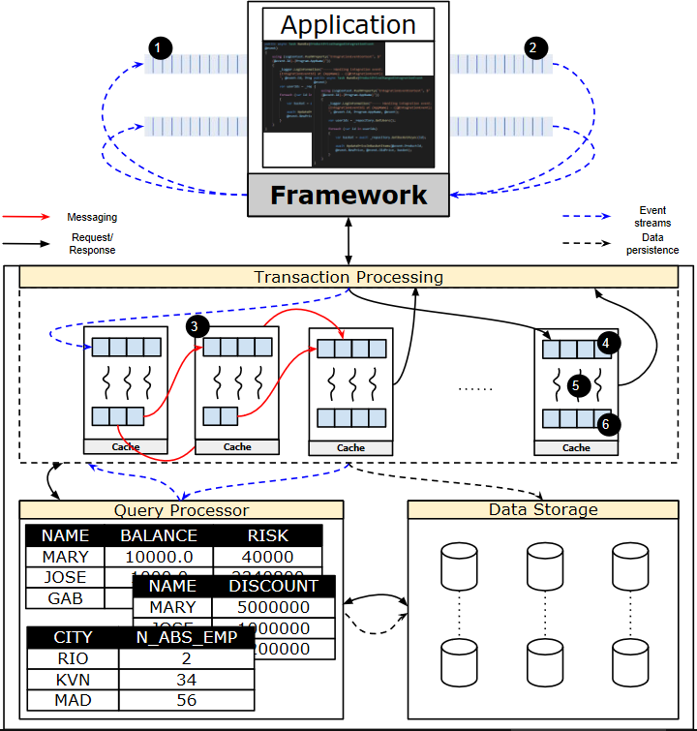
A Distributed Database System for Event-based Microservices
Virtualized microservices as the core building blocks of a database architecture.
its constraints and data dependencies, as well as abstracts inbound and outbound event streams.
In other words, by exposing internal representations of microservices

Slide 11
Enhancing Saga Pattern for Distributed Transactions within a Microservices Architecture
The resolution provides better transaction isolation by transferring few transactions to memory layer from data layer through quota cache and a service called commit-syncservice.
A cache makes it faster to get data by reducing the number of times the main memory has to be accessed.
The proposed solution handles all data related operation in memory cache server rather than a data source which is later synchronized with a service called commitsync service.

Slide 12
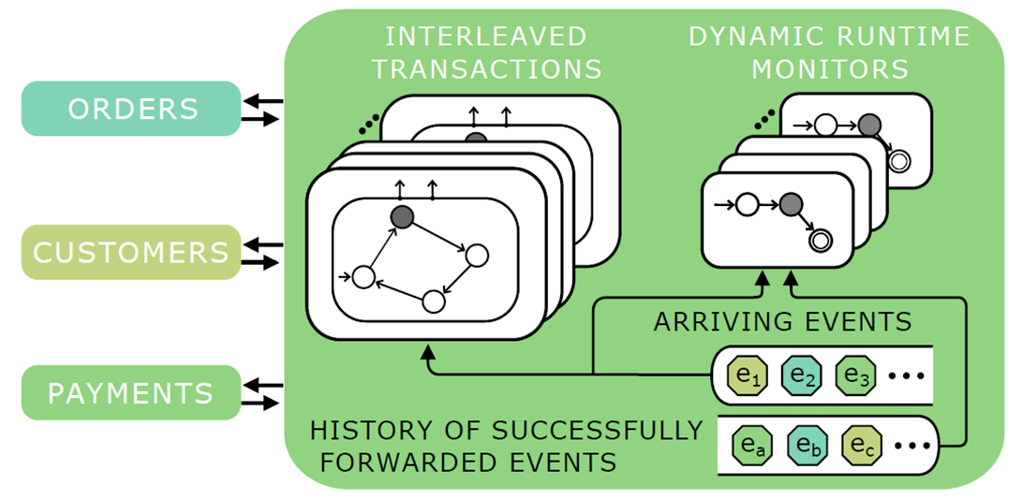
Event-Based Data-Centric Semantics for Consistent Data Management in Microservices
A coordinator is in charge of coordinating the sequence of events in relation to the states of the microservices for this reason its constraints and data dependencies, as well as abstracts inbound and outbound event streams.
Based on the current state of the functionality mechanism encapsulating the distributed transactions
The central coordinator may assess if a state change does not jeopardies transaction guarantees.

Slide 13
Research Work Adaptation Model

Slide 14
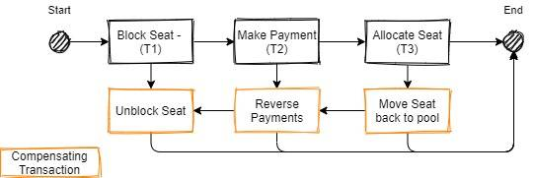
SAGA Pattern
The Saga pattern handle transaction in a distributed manner. Transaction control is dependent upon each microservices as compared to a whole transaction handling all microservices.
All transactions will be executed sequentially one after another. If any subsequent microservice failed to complete its transaction, a compensation action will be triggered to roll back the transaction to maintain consistency.

Slide 15
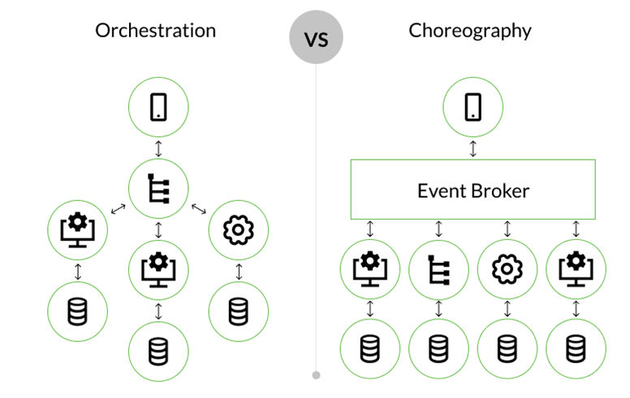
SAGA Pattern

Slide 16

Publish/Subscribe Pattern

Slide 17
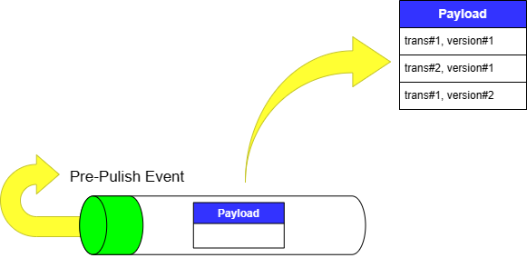
Pre-Publish Event

Slide 18
Message Broker
Message broker is the core part of this adaptation model.
In this solution message broker events must be persistent in nature so that when a service pre-publish event is captured it can access the events payload to find the availability of a service or a resource

Slide 19
Message Broker
In order to facilitate pre-publish event some information must be included along with the payload of the message. Following information are as follows:
Transaction Number: This unique id is required to track a transaction in multiple message brokers.
Version Number: A transaction can update any data multiple times which can be track by similar truncation number with different versions.
Status: This information is use to handle the status of any transaction that is pending due to any reason. in Saga compensation semantic lock are used to mark a transaction as PENDING for a particular event. When that event occurs of pending transactions are rollback according to its execution sequence.
Payload: it contains all the data and type of operation required to the subscribed services.
Data: This includes any other data required to maintain any information about distributed transaction.
Post-Event Handler: it is required for developer to handle any such which is require to execute after message processing.

Slide 20
Research Work Adaptation Model Evaluation

Slide 21
Cross Microservice Validations

Slide 22
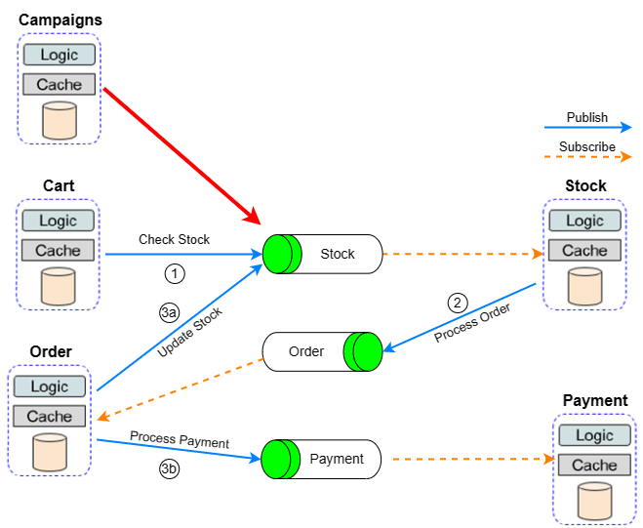
Adaptation Model: Cross Microservice Validations

Slide 23
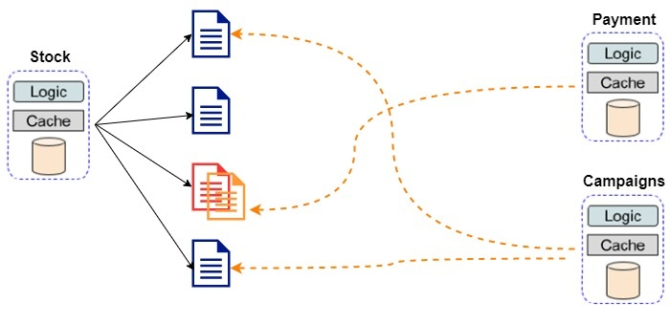
Implicit Cross Microservice Associations

Slide 24
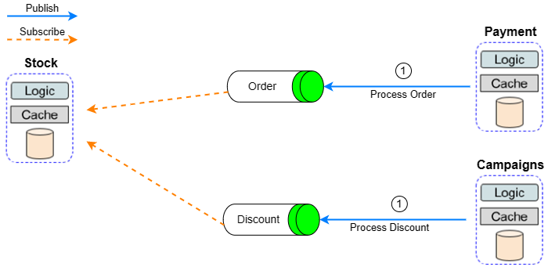
Adaptation Model: Implicit Cross Microservice Associations

Slide 25
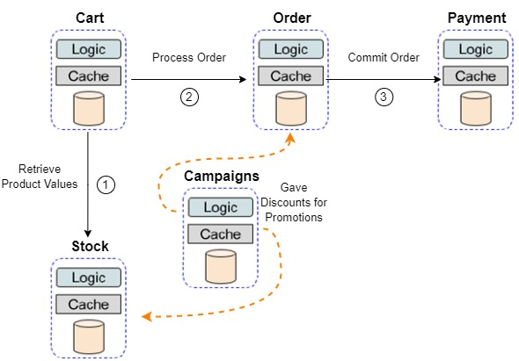
Feral Ordering

Slide 26
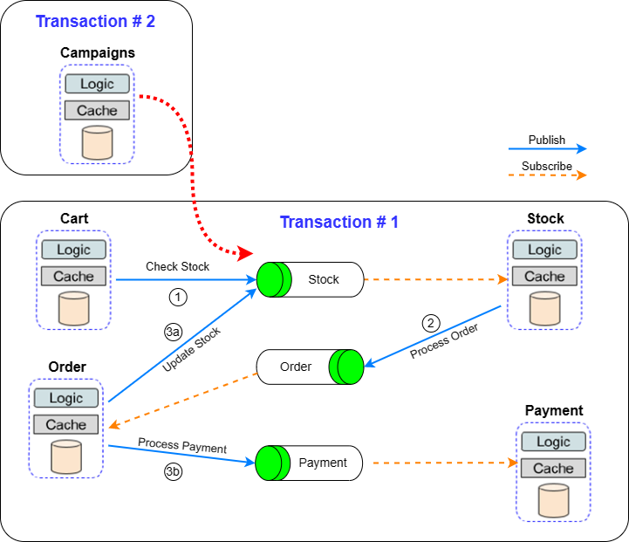
Adaptation Model: Feral Ordering

Slide 27
References
[1] System adminstrarion, Jan 2023. URL https://devops.com/.
[2] Accelerated, containerized application development, Jan 2023. URL https://www.docker.com/.
[3] Production-grade container orchestration., Jan 2023. URL https://kubernetes.io/.
[4] Apache mesos.., Jan 2023. URL https://mesos.apache.org/.
[5] S. Aydin and C. B. C， ebi. Comparison of choreography vs orchestration based saga patterns in microservices. In 2022 International Conference on Electrical, Computer and Energy Technologies (ICECET), pages 1–6. IEEE, 2022.
[6] P. Bailis and A. Ghodsi. Eventual consistency today: Limitations, extensions, and beyond. Communications of the ACM, 56(5):55–63, 2013.
[7] B. Christudas. Practical Microservices Architectural Patterns: Event-Based Java Microservices with Spring Boot and Spring Cloud. Apress, 2019.
[8] B. Christudas. Practical Microservices Architectural Patterns: Event-Based Java Microservices with Spring Boot and Spring Cloud. Apress, 2019.
[9] R. Cuomo, D. D’Agostino, and M. Ianulardo. Mobile forensics: Repeatable and nonrepeatable technical assessments. Sensors, 22(18):7096, 2022.
[10] E. Daraghmi, C.-P. Zhang, and S.-M. Yuan. Enhancing saga pattern for distributed transactions within a microservices architecture. Applied Sciences, 12(12):6242, 2022.

Slide 28
References
[11] M. de Heus, K. Psarakis, M. Fragkoulis, and A. Katsifodimos. Distributed transactions on serverless stateful functions. In Proceedings of the 15th ACM International Conference on Distributed and Event-based Systems, pages 31–42, 2021.
[12] S. Debois, T. T. Hildebrandt, and T. Slaats. Replication, refinement & reachability: complexity in dynamic condition-response graphs. Acta Informatica, 55(6):489–520, 2018.
[13] P. Di Francesco, I. Malavolta, and P. Lago. Research on architecting microservices: Trends, focus, and potential for industrial adoption. In 2017 IEEE International conference on software architecture (ICSA), pages 21–30. IEEE, 2017.
[14] L. Frank and T. U. Zahle. Semantic acid properties in multidatabases using remote procedure calls and update propagations. Software: Practice and Experience, 28(1):77–98, 1998.
[15] M. O. G¨okalp, A. Koc¸yi˘git, and P. E. Eren. A visual programming framework for distributed internet of things centric complex event processing. Computers & Electrical Engineering, 74:581–604, 2019.
[16] J.-P. Gouigoux and D. Tamzalit. From monolith to microservices: Lessons learned on an industrial migration to a web oriented architecture. In 2017 IEEE international conference on software architecture workshops (ICSAW), pages 62–65. IEEE, 2017.
[17] W. Hasselbring and G. Steinacker. Microservice architectures for scalability, agility and reliability in e-commerce. In 2017 IEEE International Conference on Software Architecture Workshops (ICSAW), pages 243–246. IEEE, 2017.
[18] R. Laigner, M. Kalinowski, P. Diniz, L. Barros, C. Cassino, M. Lemos, D. Arruda, S. Lifschitz, and Y. Zhou. From a monolithic big data system to a microservices event-driven architecture. In 2020 46th Euromicro Conference on Software Engineering and Advanced Applications (SEAA), pages 213–220. IEEE, 2020.

Slide 29
Question & Answer Session
Thank you

